Slide 1
Chapter 2.2
The Metric System

Slide 2
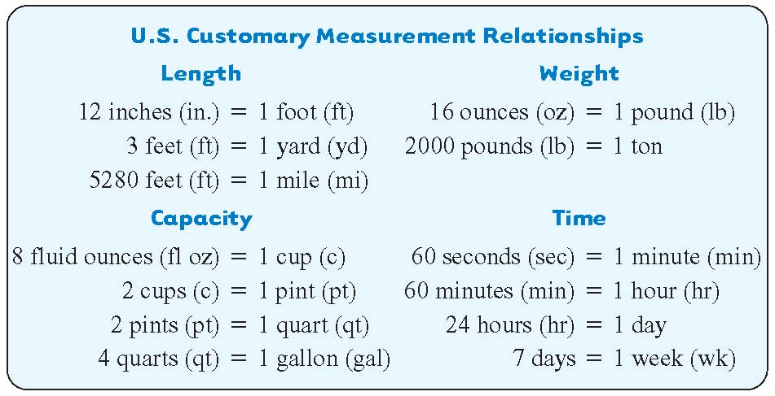

Slide 3
Parallel
Example 1
Knowing U.S. Customary Measurement Units
Memorize the U.S. customary measurement conversions shown on the previous slide. Then answer these questions.
1
a. 3 ft = ________ yd
4
b. 1 gal = ________ qt
60
c. 1 hr = ________ min
1
d. 16 oz = ________ lb

Slide 4
Converting among Measurement Units
Multiply when converting from a larger unit to a smaller unit.
Divide when converting from a smaller unit to a larger unit.

Slide 5
Parallel
Example 2
Converting from One Unit of Measure to Another
Convert each measurement.
a. 9 ft to inches.
Recall, 1 ft = 12 in.
larger unit to a smaller unit ➔ multiply
9 ft = 9 • 12 = 108 in.
1
b. 6 lb to ounces.
Recall, 1 lb = 16 oz.
2
larger unit to a smaller unit ➔ multiply
1
1
6 lb = 6 • 16 = 104 oz
2
2

Slide 6
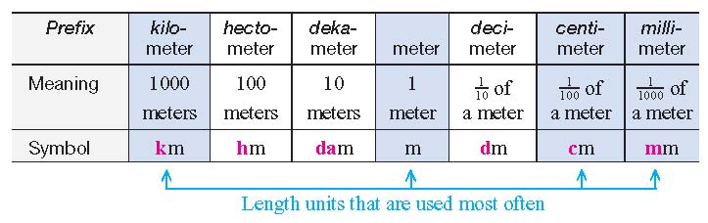
The basic unit of length in the metric system is the meter. Use the symbol m for meter, do not put a period after it. To make longer or shorter units in the metric system, prefixes are written in front of the word meter. The table below shows how to use the prefixes for length measurement.
Slide 7.2- 6

Slide 7
Here are some comparisons with commonly used length units: km, m, cm, mm.
Kilometer – Used instead of a mile. A kilometer is 1000 meters. It is about 0.6 mile.
Centimeter – Used instead of inches. A centimeter is 1/100 of a meter. It is a little shorter than ½ inch. The width of your little finger is about 1 cm.
Millimeter –A millimeter is 1/1000 of a meter. The thickness of one dime is about 1 mm.
Slide 7.2- 7

Slide 8
Parallel
Example 1
Using Metric Length Units
Write the most reasonable unit in each blank. Choose from km, m, cm, and mm.
a.
The distance from your office to your home is 30 ________.
30 km because kilometers are used instead of miles. 30 km is about 18 ½ miles.
b.
The thickness of cardboard is 3_____.
3 mm because the thickness of cardboard is very small.
c.
The length of your calculator is 18 _____ long.
18 cm which is about 7 inches.
Slide 7.2- 8

Slide 9
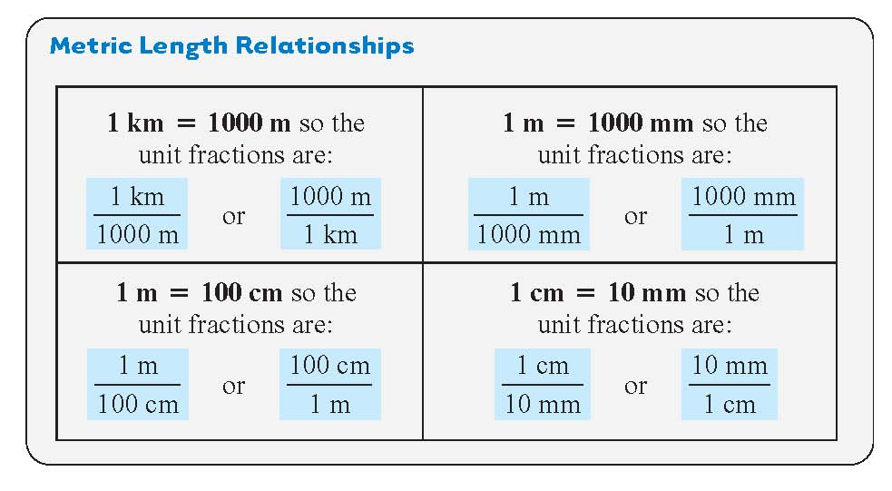
Slide 7.2- 9

Slide 10
Parallel
Example 2
Using Unit Fractions to Convert Length Measurements
Convert each measurement using unit fractions.
a.
7 km to meters
Unit fraction
equivalent to 1
Unit for answer
Unit being changed
Multiply. Divide out common units where possible.
These units should match.
7 km = 7000 m
Slide 7.2- 10

Slide 11
Parallel
Example 2
continued
Using Unit Fractions to Convert Length Measurements
Convert each measurement using unit fractions.
b.
92.7 cm to m
Multiply by a unit fraction that allows you to divide out centimeters.
92.7cm = 0.927 m
There are 100 cm in a meter, and 92.7 cm is almost a meter. The answer makes sense.
Slide 7.2- 11

Slide 12
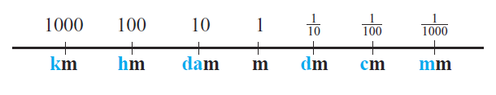
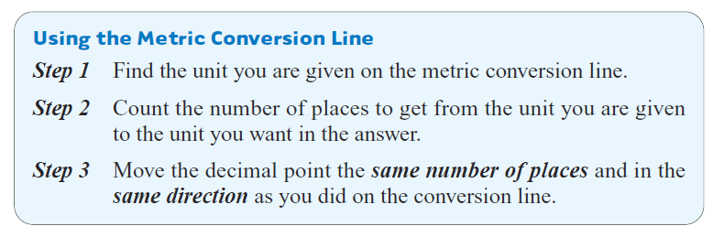
An alternative conversion method to unit fractions is moving the decimal point using this metric conversion line.
Slide 7.2- 12

Slide 13
Parallel
Example 3
Using the Metric Conversion Line
Use the metric conversion line to make the following conversions.
a.
4.658 km to m
Find km on the metric conversion line. To get to m, you move three places to the right.
km
hm
dam
m
dm
cm
mm
4. 6 5 8
Three places to the right.
Move the decimal point three places to the right.
4.658 km = 4658 m
Slide 7.2- 13

Slide 14
Parallel
Example 3
continued
Using the Metric Conversion Line
Use the metric conversion line to make the following conversions.
b.
49.7 cm to m
Find cm on the metric conversion line. To get to m, you move two places to the left.
km
hm
dam
m
dm
cm
mm
4 9 . 7
Two places to the left.
Move the decimal point two places to the left.
49.7 cm = 0.497 m
Slide 7.2- 14

Slide 15
Parallel
Example 4
Practicing Length Conversions
Convert using metric conversion line.
a.
29 cm to m
From cm to m is two places to the left. The decimal point starts at the far right because 29 is a whole number. Then move it two places to the left.
2 9.
29 cm = 0.29 m
b.
b.
5.18 cm to km
5.18 cm to km
From cm to km is five places to the left.
.
0 0 0 0 5.1 8
5.18 cm = 0.0000518 km
Slide 7.2- 15

Slide 16
We use capacity units to measure liquids, such as the amount of milk in a recipe, the gasoline in our car tank, and the water in an aquarium.
The basic metric unit for capacity is the liter.
The capital letter L is the symbol for liter.

Slide 17
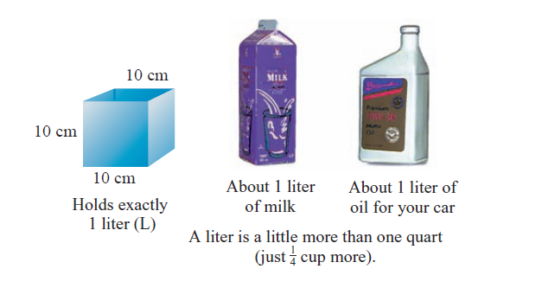
A liter is just a little more than 1 quart.

Slide 18
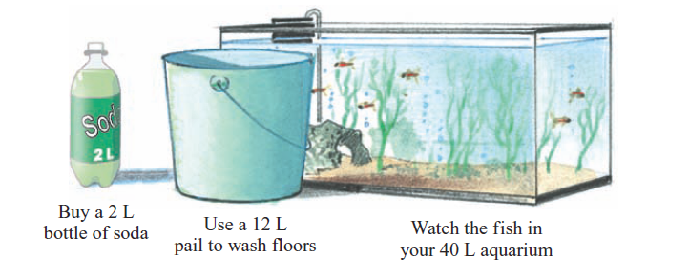
In the metric system you use liters for things like buying milk and soda, filling a pail with water, and describing the size of your home aquarium.

Slide 19
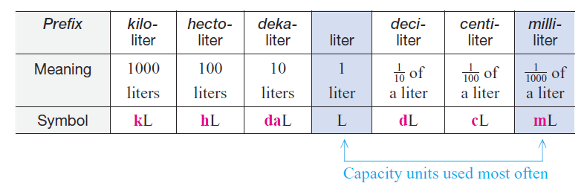
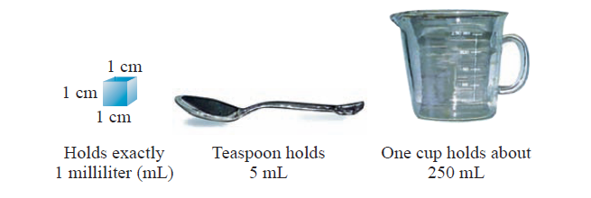

Slide 20
Parallel
Example 1
Using Metric Capacity Units
Write the most reasonable metric unit in each blank. Choose from L and mL.
a. The can of soup held 270 _______.
mL
L
b. I bought a 2 _____ container of milk.

Slide 21
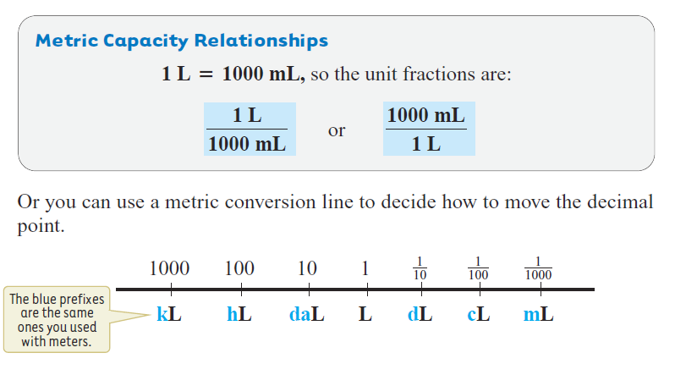

Slide 22
Parallel
Example 2
Converting among Metric Capacity Units
Convert using the metric conversion line or unit fractions.
3.4 L to mL
Conversion line: Unit Fractions:
Multiply by a unit fraction that allows you to divide out liters.
From L to mL is three
places to the right.
3. 400
Write two zeros as
placeholders.
3.4 L = 3400 mL

Slide 23
Parallel
Example 2
Converting among Metric Capacity Units
Convert using the metric conversion line or unit fractions.
b. 60 mL to L
Conversion line: Unit Fractions:
Multiply by a unit fraction that allows you to divide out mL.
From mL to L is three
places to the left.
060.
Move decimal point
three places
to the left.
60 mL = 0.06 L

Slide 24
The units you will use most often in daily life are kilograms (kg), grams (g), and milligrams (mg).
Kilograms are used instead of pounds.
Extremely small weights are measured in milligrams. Dosages of medicine and vitamins are given in milligrams.

Slide 25
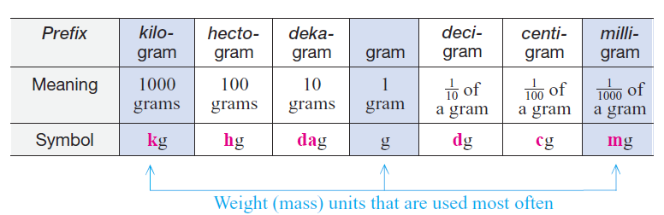
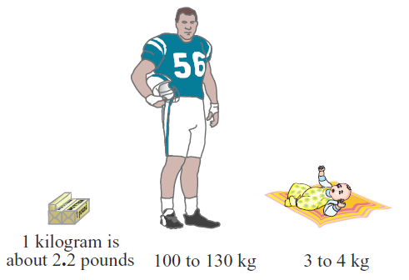

Slide 26
Parallel
Example 1
Using Metric Weight Units
Write the most reasonable metric unit in each blank. Choose from kg, g, and mg.
a. Trisha’s bag of dog food weighed 25 _______.
kg
mg
b. Catherine took a 30 ____ vitamin.
c. Nicholas ate an apple that weighted about 50 _____.
g

Slide 27
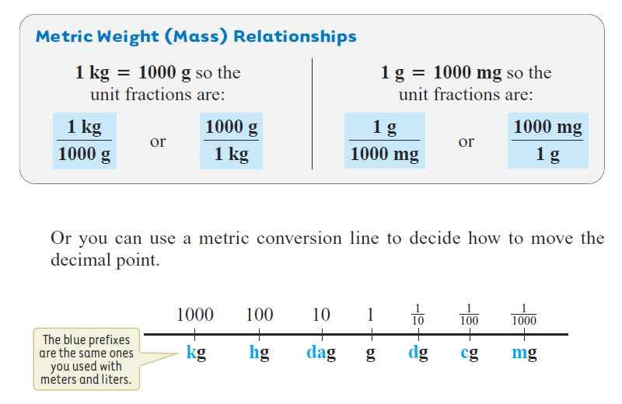

Slide 28
Parallel
Example 4
Converting among Metric Weight Units
Convert using the metric conversion line or unit fractions.
a. 8 mg to g
Conversion line: Unit Fractions:
Multiply by a unit fraction that allows you to divide out mg.
From mg to g is three
places to the left.
008.
Move decimal point
three places
to the left.
8 mg = 0.008 g

Slide 29
Hw
2.2
1-38

